Slide 1
Deep Neural Networks: Attention Mechanism and Transformers
CS771: Introduction to Machine Learning
Piyush Rai

Slide 2










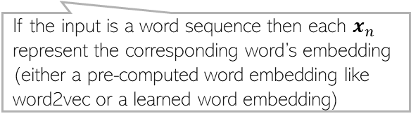




























Recap: RNNs
2
RNNs are used when each input or output or both are sequences of tokens
Hidden state $h_{t}$ is supposed to remember everything up to time $t−1$. However, in practice, RNNs have difficulties remembering the distant past
Variants such as LSTM, GRU, etc mitigate this issue to some extent
Slow processing is another major issue (e.g., can’t compute $h_{t}$ before computing $h_{t−1}$)
$$y_{1}$$
$$y_{2}$$
$$y_{3}$$
$$y_{t}$$
Decoder part
$$y_{T}$$
$$y_{t}$$
$$v$$
$$v$$
$$v$$
$$v$$
$$v$$
Compactly
$$v$$
$$h_{1}$$
$$U$$
$$h_{2}$$
$$U$$
$$h_{3}$$
$$U$$
$$U$$
$$h_{t}$$
$$U$$
$$U$$
$$h_{T}$$
$$h_{t}$$
$$U$$
$$W$$
$$W$$
$$W$$
$$W$$
$$W$$
$$W$$
$$x_{1}$$
$$x_{2}$$
$$x_{3}$$
$$x_{t}$$
Encoder part
$$x_{T}$$
$$x_{t}$$
If the input is a word sequence then each $x_{n}$ represent the corresponding word’s embedding (either a pre-computed word embedding like word2vec or a learned word embedding)

Slide 3
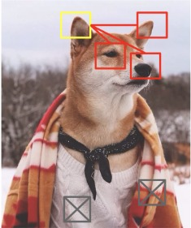
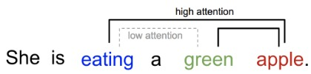
Attention
3
We use attention to “focus” on some part of interest in an input
Other nearby relevant parts help us focus
Other irrelevant parts do not contribute in the process
In sequence modeling problems, we can use attention between input and output tokens (between encoder and decoder parts), as well as among the inputs only (only within the encoder part)
Pic credit: https://lilianweng.github.io/posts/2018-06-24-attention/

Slide 4
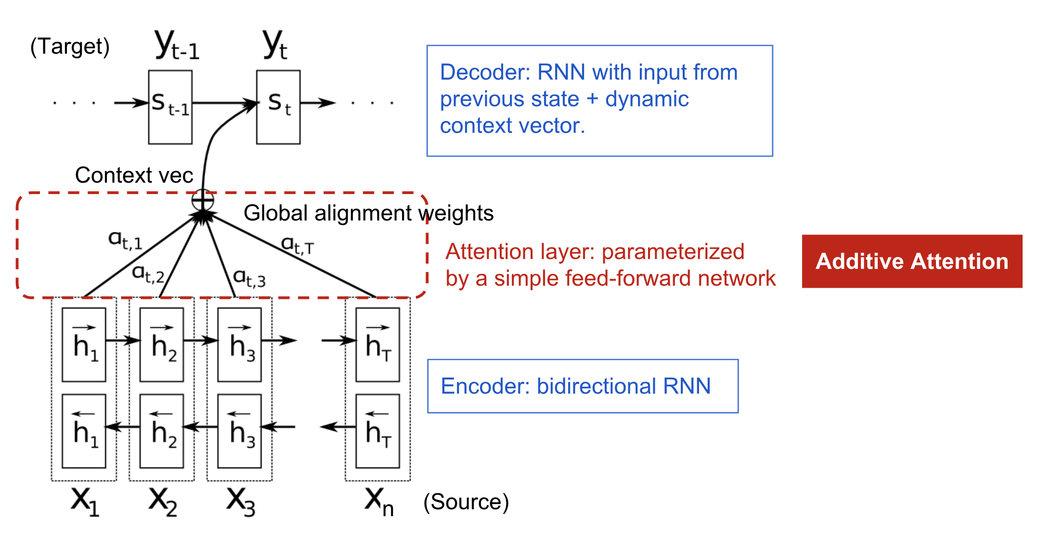

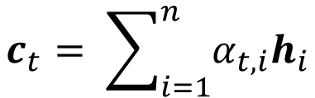

RNN with Attention
4
RNNs have also been augmented with attention to help remember the distant past
Attention mechanism for a bi-directional RNN encoder-decoder model
Decoder’s output $y_{t}$ at step $t$ assumed to depend on the previous state $s_{t−1}$ in the decoder and an input context vector $c_{t}$
$$h_{i}= \left[\begin{aligned}{\vec{h}}_{i} \\ {\overset{⃖}{h}}_{i}\end{aligned}\right]$$
$$c_{t}= \sum_{i=1}^{n}{α_{t,i}h_{i}}$$
T

Slide 5
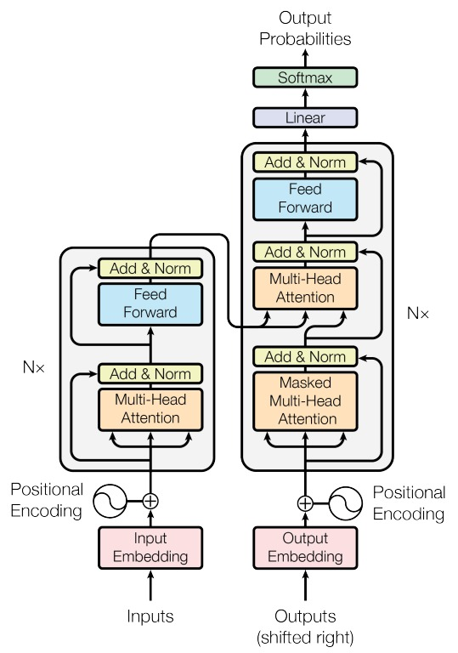
Transformers
5
Transformers also use the idea of attention but in a different way, namely “self-attention” (attention not between input and output tokens but among the input token themselves)
In addition, transformer also bring in parallelism in modeling of sequential data
Hidden states of all the tokens can be computed in parallel
Transformers are based on the following key ideas*
“Self-attention” for computing the hidden states
Positional encoding
Residual connections
Attention helps capture the context better and in a much more “global” manner in sequence data
Nx means these layers repeated a number of times (say N)
“Residual connections”
Attention mechanism
“Attention is all you need” (Vaswani et al, 2017)

Slide 6
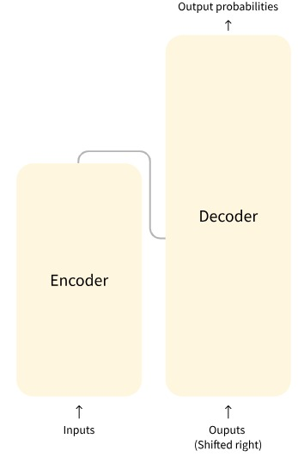
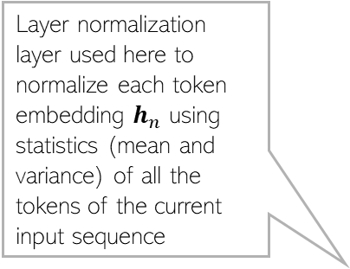
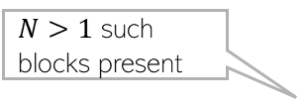
Transformers
6
The block diagram of a transformer encoder-decoder architecture
Layer normalization layer used here to normalize each token embedding $h_{n}$ using statistics (mean and variance) of all the tokens of the current input sequence
$N>1$ such blocks present
“Residual connections”
Note however that the encoding of all input tokens happens all in parallel (and that’s the advantage over RNN)
Attention mechanism
Uses multiple heads to capture multiple notions of similarity
“Shifted right” simply means that we are generating each output token conditioned on the previously generate token
Pic source: “Attention is all you need” (Vaswani et al, 2017)

Slide 7

Transformers: Self-Attention
7
Transformers use “self-attention” for computing the hidden states
With self-attention, each token $x_{n}$ can “attend to” all other tokens when the encoder computes its embedding $h_{n}$
Attention helps capture the context better and in a much more “global” manner
“Global”: Long ranges captures and in both directions (previous and ahead)
The input sequence but differing in the last word (tired -> wide)
An input sequence
How much the word “it” is being “attended to” by other words in the input sequence
Note how the attention has changed
Example credit: https://blog.research.google/2017/08/transformer-novel-neural-network.html

Slide 8

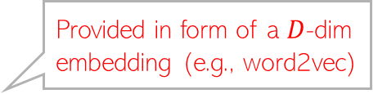

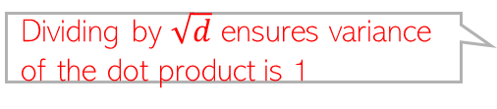


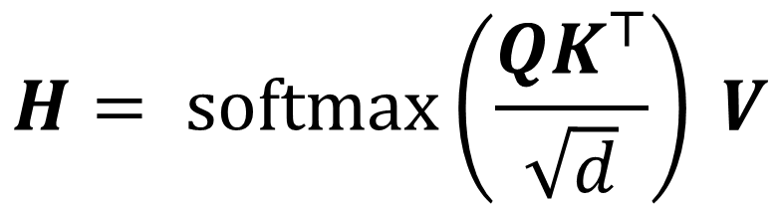
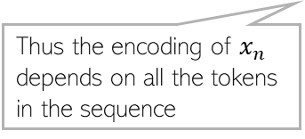




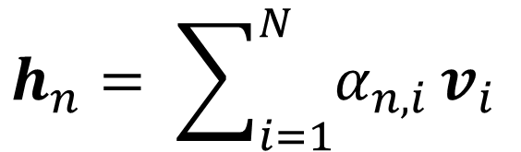
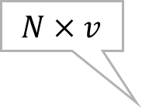





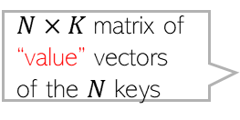
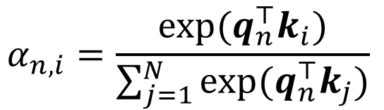


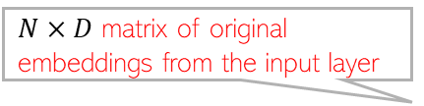
Using Self-Attention for Token Encoding
8
Provided in form of a $D$-dim embedding (e.g., word2vec)
For an $N$ length sequence, the attention scores for each token $x_{n}$ are computed using
A query vector $q_{n}$ associated with that token
$N$ key vectors $K=\{k_{1},k_{2},…, k_{N}\}$ (one per token)
$N$ value vectors $V=\{v_{1},v_{2},…, v_{N}\}$ associated with the key vectors
One way to compute the attention score is
Given attention scores, encoder’s hidden state for $x_{n}$ is
$N×D$ matrix of original embeddings from the input layer
Linear projection by $D×d$ matrix
$N×d$matrix of “queries”
$$Q=XW_{Q}$$
Learnable
Row $n$ is $q_{n}$
$D×d$ matrix. Learnable
$N×d$matrix of $N$ “keys”
Assuming same size $d$ as query
$$K=XW_{K}$$
$N×K$matrix of “value” vectors of the $N$ keys
$D×$K matrix. Learnable
How much token $i$ attends to token $n$
$$α_{n,i}=\frac{exp(q_{n}^{⊤}k_{i})}{\sum_{j=1}^{N}{exp(q_{n}^{⊤}k_{j})}}$$
Dot-product attention (query and key assumed $d$ dimensional)
$$V=XW_{V}$$
$Q$ and $K$ are assumed $N×d$
$$N×v$$
$$H= softmax\left(\frac{QK^{⊤}}{\sqrt{d}}\right) V$$
Attention-weighted sum of the value vectors of all the tokens in the sequence
$$h_{n}= \sum_{i=1}^{N}{α_{n,i}}v_{i}$$
$$N×v$$
Thus the encoding of $x_{n}$ depends on all the tokens in the sequence
Dividing by $\sqrt{d}$ ensures variance of the dot product is 1
“Scaled” dot-product attention

Slide 9
Multi-head Attention (MHA)
9
A single attention function can capture only one notion of similarity
Transformers therefore use multi-head attention (MHA)
MHA
Single Attention
Output
Output
Concatenate and Project
Attention
Output
Output
Output
Query
Keys
Values
Attention
Attention
Attention
Query
Keys
Values
Query
Keys
Values
Query
Keys
Values
Pic credit: https://huggingface.co/learn/nlp-course/chapter1/

Slide 10
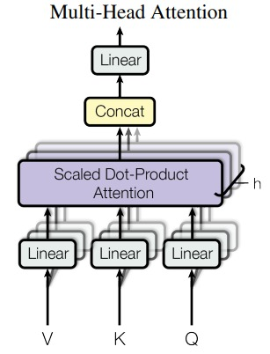

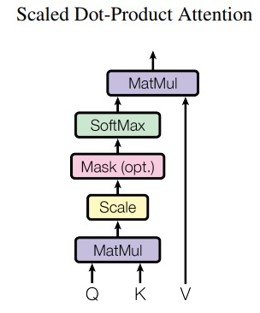
Transformers: The Overall Architecture
10
Zooming in..
Here, on the output side, we used “masked” MHA because during output generation, we don’t want to look at future tokens
Pic source: “Attention is all you need” (Vaswani et al, 2017)

Slide 11
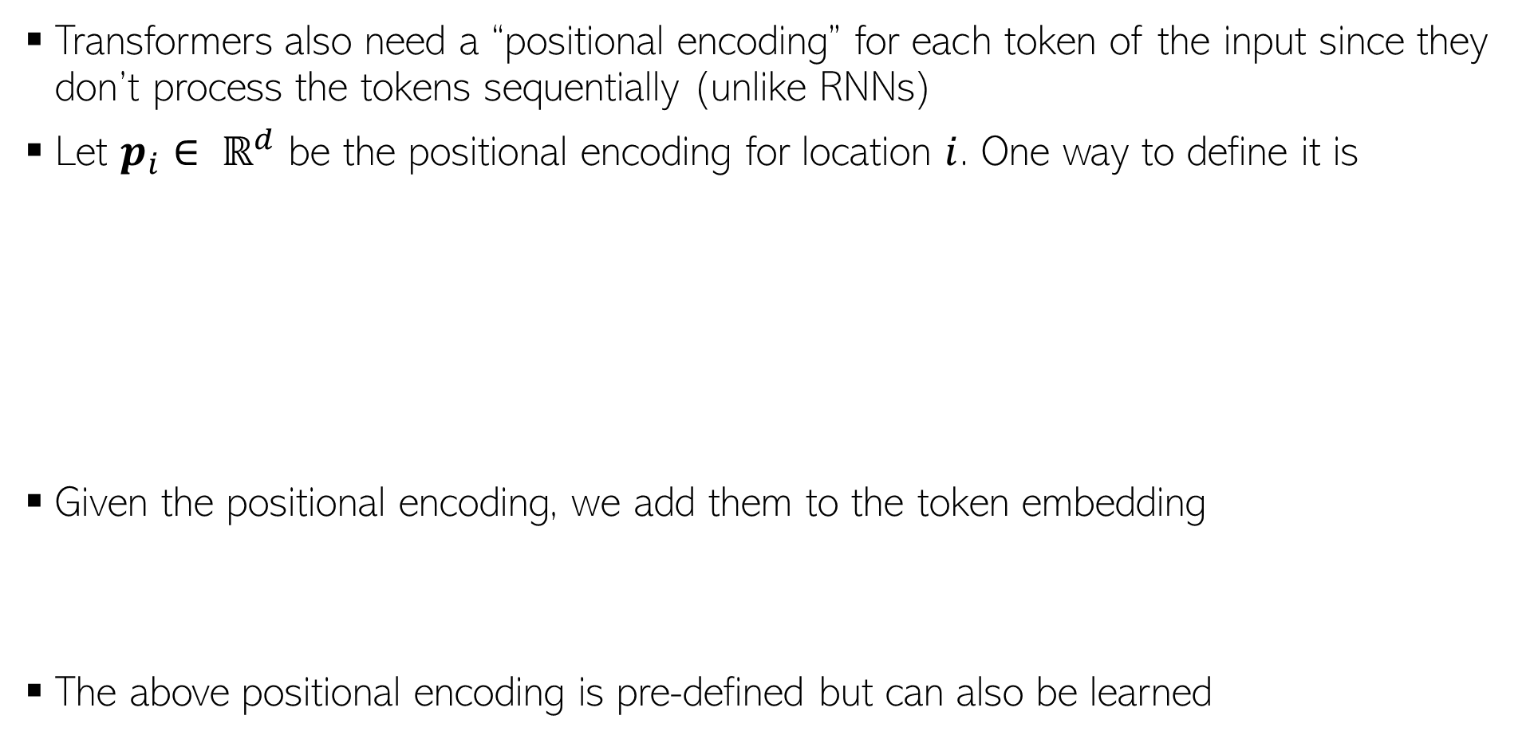
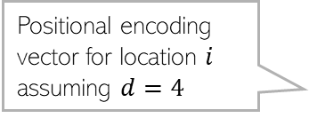
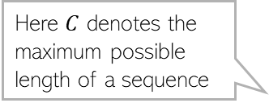

Transformers: Positional Encoding
11
Transformers also need a “positional encoding” for each token of the input since they don’t process the tokens sequentially (unlike RNNs)
Let $p_{i}∈ ℝ^{d}$ be the positional encoding for location $i$. One way to define it is
Given the positional encoding, we add them to the token embedding
The above positional encoding is pre-defined but can also be learned
Here $C$ denotes the maximum possible length of a sequence
Note the smooth transition as the position index changes
Positional encoding vector for location $i$ assuming $d=4$
$${\hat{x}}_{i}=x_{i}+p_{i}$$
Pic credit: PML-1 (Murphy, 2023)

Slide 12
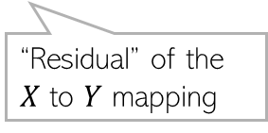
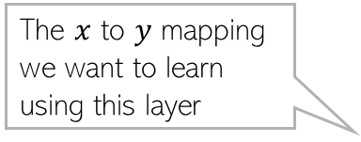
Residual Connections
12
Transformers contain a very large number of layers
In general, just stacking lots of layer doesn’t necessarily help a deep learning model
Vanishing/exploding gradient may make learning difficult
Skip connections or “residual connections” help if we want very deep networks
This idea was popularized by “Residual Networks”* (ResNets) which can have very large number of layers
Basic idea: Don’t force a layer to learn everything about a mapping
Let the layer just learn the “residual” and add the original input
If the residual’s and input’s dimension are different then we apply a projection on the inputs to match the dimensions
The $x$ to $y$ mapping we want to learn using this layer
$$Y=f\left(X;W\right)=g\left(conv\left(X\right)\right)+X$$
“Residual” of the $X$ to $Y$ mapping
*Deep Residual Learning for Image Recognition (He et al, 2015)
Pic credit: PML-1 (Murphy, 2023)

Slide 13
Transformers have many variants
13
BERT (Bidirectional Encoder Representations from Transformers)
GPT (Generative Pretrained Transformer)
T5 (Text-to-Text Transfer Transformer)
Vision Transformers (ViT)

